Slide 1
Self Organizing Maps – Kohonen Algorithm Part II

Slide 2
Brain Maps

Slide 3
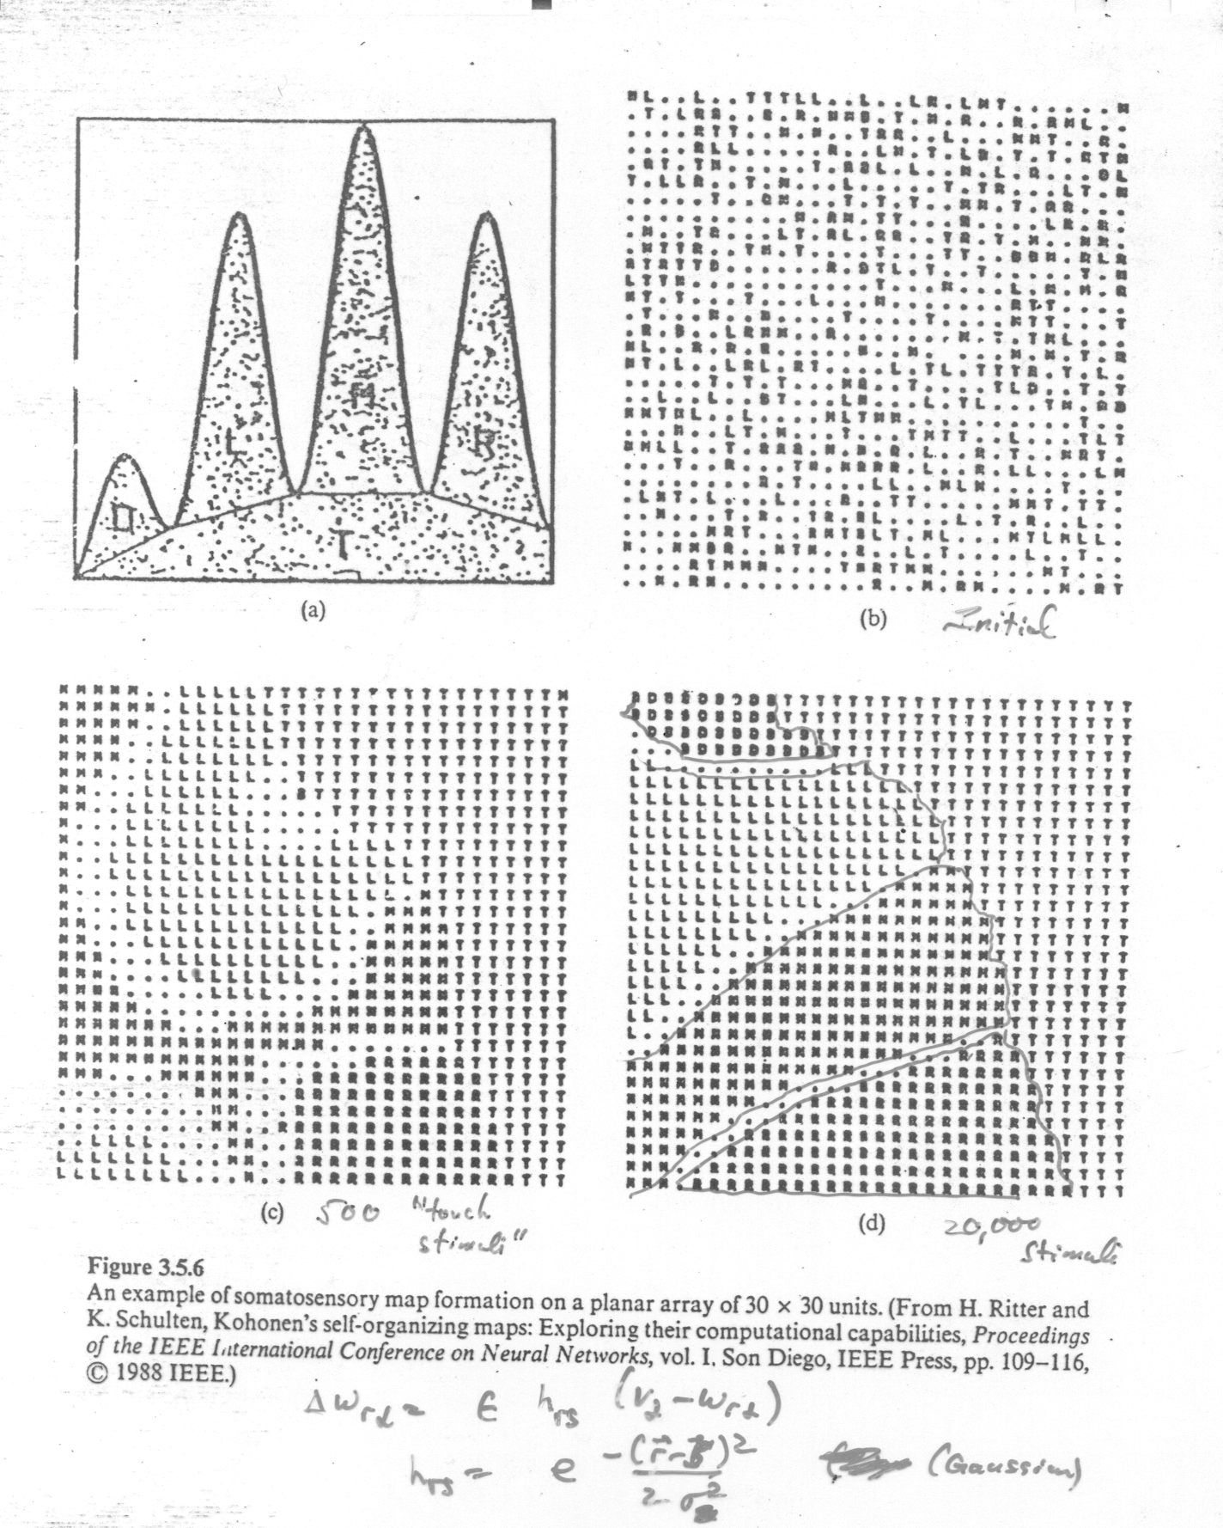

Slide 4
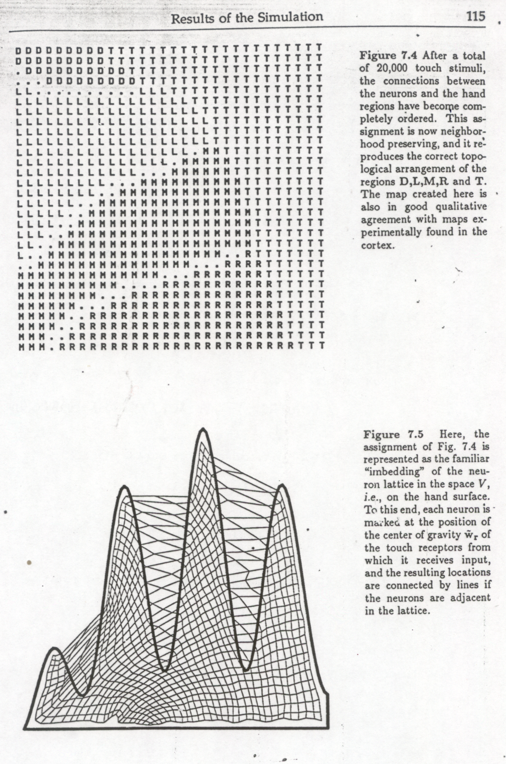

Slide 5
